Slide 1

Course code : CSE3009 Course title : No SQL Data Bases Module : 5 Topic : 3
Cassandra Query Language

Slide 2
Objectives
This session will give the knowledge about
Cassandra Query Language

Slide 3
Cassandra Query Language
By default, Cassandra provides a prompt Cassandra query language shell (cqlsh) that allows users to communicate with it. Using this shell, you can execute Cassandra Query Language (CQL).
Using cqlsh, you can
define a schema,
insert data, and
execute a query.

Slide 4
CQL Documented Shell Commands
HELP − Displays help topics for all cqlsh commands.
CAPTURE − Captures the output of a command and adds it to a file.
CONSISTENCY − Shows the current consistency level, or sets a new consistency level.
COPY − Copies data to and from Cassandra.
DESCRIBE − Describes the current cluster of Cassandra and its objects.
EXPAND − Expands the output of a query vertically.

Slide 5
CQL Documented Shell Commands
EXIT − Using this command, you can terminate cqlsh.
PAGING − Enables or disables query paging.
SHOW − Displays the details of current cqlsh session such as Cassandra version, host, or data type assumptions.
SOURCE − Executes a file that contains CQL statements.
TRACING − Enables or disables request tracing.

Slide 6
CQL Data Types
Data Type | Constants | Description
ascii | strings | Represents ASCII character string
bigint | bigint | Represents 64-bit signed long
blob | blobs | Represents arbitrary bytes
Boolean | booleans | Represents true or false
counter | integers | Represents counter column

Slide 7
CQL Data Types
Data Type | Constants | Description
decimal | integers, floats | Represents variable-precision decimal
double | integers | Represents 64-bit IEEE-754 floating point
float | integers, floats | Represents 32-bit IEEE-754 floating point
inet | strings | Represents an IP address, IPv4 or IPv6
int | integers | Represents 32-bit signed int

Slide 8
CQL Data Types
Data Type | Constants | Description
text | strings | Represents UTF8 encoded string
timestamp | integers, strings | Represents a timestamp
timeuuid | uuids | Represents type 1 UUID
uuid | uuids | Represents type 1 or type 4
varchar | strings | Represents uTF8 encoded string
varint | integers | Represents arbitrary-precision integer

Slide 9
CQL Collection Types
Collection | Description
list | A list is a collection of one or more ordered elements.
map | A map is a collection of key-value pairs.
set | A set is a collection of one or more elements.

Slide 10
CQL Data Definition Commands
CREATE KEYSPACE − Creates a KeySpace in Cassandra.
USE − Connects to a created KeySpace.
ALTER KEYSPACE − Changes the properties of a KeySpace.
DROP KEYSPACE − Removes a KeySpace
CREATE TABLE − Creates a table in a KeySpace.
ALTER TABLE − Modifies the column properties of a table.
DROP TABLE − Removes a table.
TRUNCATE − Removes all the data from a table.
CREATE INDEX − Defines a new index on a single column of a table.
DROP INDEX − Deletes a named index.

Slide 11
CQL Data Definition Commands
CREATE KEYSPACE − Creates a KeySpace in Cassandra.
Syntax
CREATE KEYSPACE <identifier> WITH <properties>
CREATE KEYSPACE “KeySpace Name” WITH replication = {'class': ‘Strategy name’, 'replication_factor' : ‘No.Of replicas’} AND durable_writes = ‘Boolean value’; USE − Connects to a created KeySpace.
Example
CREATE KEYSPACE University WITH replication = {'class':'SimpleStrategy', 'replication_factor' : 3};

Slide 12
CQL Data Definition Commands
Strategy: While declaring strategy name in Cassandra. There are two kinds of strategies declared in Cassandra Syntax.
Simple Strategy: Simple strategy is used when you have just one data center. In this strategy, the first replica is placed on the node selected by the partitioner. Remaining nodes are placed in the clockwise direction in the ring without considering rack or node location.
Network Topology Strategy: Network topology strategy is used when you have more than one data centers. In this strategy, you have to provide replication factor for each data center separately. Network topology strategy places replicas in nodes in the clockwise direction in the same data center. This strategy attempts to place replicas in different racks.
Replication Factor: Replication factor is the number of replicas of data placed on different nodes. For no failure, 3 is good replication factor. More than two replication factor ensures no single point of failure.

Slide 13
CQL Data Definition Commands
DESCRIBE keyspaces;
SELECT * FROM system.schema_keyspaces;
CREATE KEYSPACE cse WITH REPLICATION = { 'class' : 'NetworkTopologyStrategy', 'datacenter1' : 3 } AND DURABLE_WRITES = false;

Slide 14
Durable Writes
Durable Writes provides a means to instruct Cassandra whether to use "commitlog" for updates on the current KeySpace or not. This option is not mandatory. The default value for durable writes is TRUE.
When Cassandra write: 1. memtable (in memory) 2. commit log (In persistence storage) before writing into, to safeguard the data, just incase of system restart. 3. SSTABLE. (In persistence storage)
So, using "durable writes" it make sure the insert/update must write in commit log so the safeguard stay in place.

Slide 15
CQL Data Definition Commands
USE University;
ALTER KEYSPACE University WITH REPLICATION = { 'class' : 'NetworkTopologyStrategy', 'datacenter1' : 1 };
ALTER KEYSPACE University WITH REPLICATION = { 'class' : 'NetworkTopologyStrategy', 'datacenter1' : 1 } AND DURABLE_WRITES = false;
DROP KEYSPACE University;

Slide 16
CQL Data Definition Commands
CREATE TABLE emp(emp_id int PRIMARY KEY, emp_name text,emp_city text, emp_sal int, emp_phone int);
select * from emp;
ALTER TABLE University.emp
ALTER emp_id TYPE int;
ADD emp_email text;
DROP emp_phone;
RENAME emp_city TO emp_address;
DROP TABLE University.emp

Slide 17
CQL Data Definition Commands
DESCRIBE COLUMNFAMILIES;
TRUNCATE University.emp;
INSERT INTO University.Emp(emp_id,emp_city,emp_name,emp_sal) VALUES(2,'ap','sample1', 2000);
UPDATE University.Emp SET emp_name='Hayden' WHERE emp_id=1;
UPDATE University.Emp SET emp_name='Hayden' WHERE emp_id=2;
SELECT emp_name, emp_sal from University.emp;

Slide 18
CQL Data Definition Commands
DELETE emp_sal FROM University.emp WHERE emp_id=3;
DELETE FROM University.Emp WHERE emp_id=1;
CREATE INDEX e_name ON University.emp(emp_name);
DROP INDEX IF EXISTS University.e_name;
INSERT INTO University.Emp(emp_id,emp_city,emp_name,emp_sal) VALUES(3,‘hyd','sample2', 2300) USING TTL 100;

Slide 19
BATCH
In Cassandra BATCH is used to execute multiple modification statements (insert, update, delete) simultaneously. It is very useful when you have to update some column as well as delete some of the existing.
BEGIN BATCH
<insert-stmt>/ <update-stmt>/ <delete-stmt>
APPLY BATCH

Slide 20
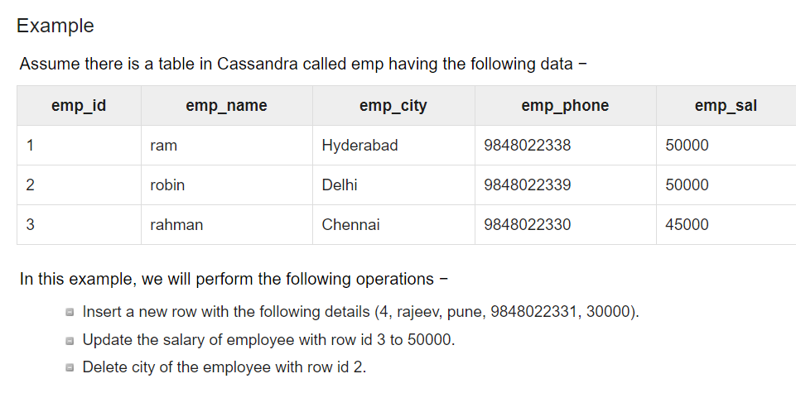
BATCH

Slide 21
BATCH
BEGIN BATCH
... INSERT INTO emp (emp_id, emp_city, emp_name, emp_phone, emp_sal) values( 4,'Pune','rajeev',98480, 30000);
... UPDATE emp SET emp_sal = 50000 WHERE emp_id =3;
... DELETE emp_city FROM emp WHERE emp_id = 2;
... APPLY BATCH;

Slide 22
CQL Collections
CREATE TABLE University.student(stu_id INT, stu_name TEXT, stu_Email SET<TEXT>, PRIMARY KEY(stu_id));
INSERT INTO University.student(stu_id,stu_name,stu_Email) VALUES(123,'test1',{'abc@gmail.com','xyz@hotmail.com'});
INSERT INTO customer(cust_id ,Cust_name, Cust_address , Cust_mob, Cust_email , Bill_amount ) VALUES (101, 'John',{'No':'123','Street': 'Roy street','City': 'Vijayawada','State': 'AP'}, ['9876534567','9878998787'], {'jon@gmail.com', 'john@gmail.com'}, 12000 );

Slide 23
CQL User-defined Data Type
CREATE TYPE university.card_details(num int,pin int,name text,cvv int);
ALTER TYPE university.card_details ADD expire text;
DESCRIBE TYPE card_details;
DESCRIBE TYPES;
DROP TYPE card_details;

Slide 24
CQL User-defined Data Type
CREATE TYPE address ( employee_id int, residence_address text, office_address text, city text );
CREATE TABLE employee ( employee_id int PRIMARY KEY, name text, address frozen<address>, salary text);
INSERT INTO employee JSON '{"employee_id":1234, "name":"Akhil", "address":{"employee_id":1234,"residence_address":"65A Block","office_address":"75D Block","city":"Goa"}, "salary":"12000"}';

Slide 25
Summary
This session will give the knowledge about
Cassandra Query Language

